Slide 1
Research 101
August 20, 2024
Amanda Brooks, PhD
Vice Provost of Research and Scholarly Activity
Professor of Molecular Biology
abrooks@rvu.edu
Karma McKelvey, PhD
Assistant Director of Research and Scholarly Activity
Associate Professor of Public Health
kmckelvey@rvu.edu

Slide 2
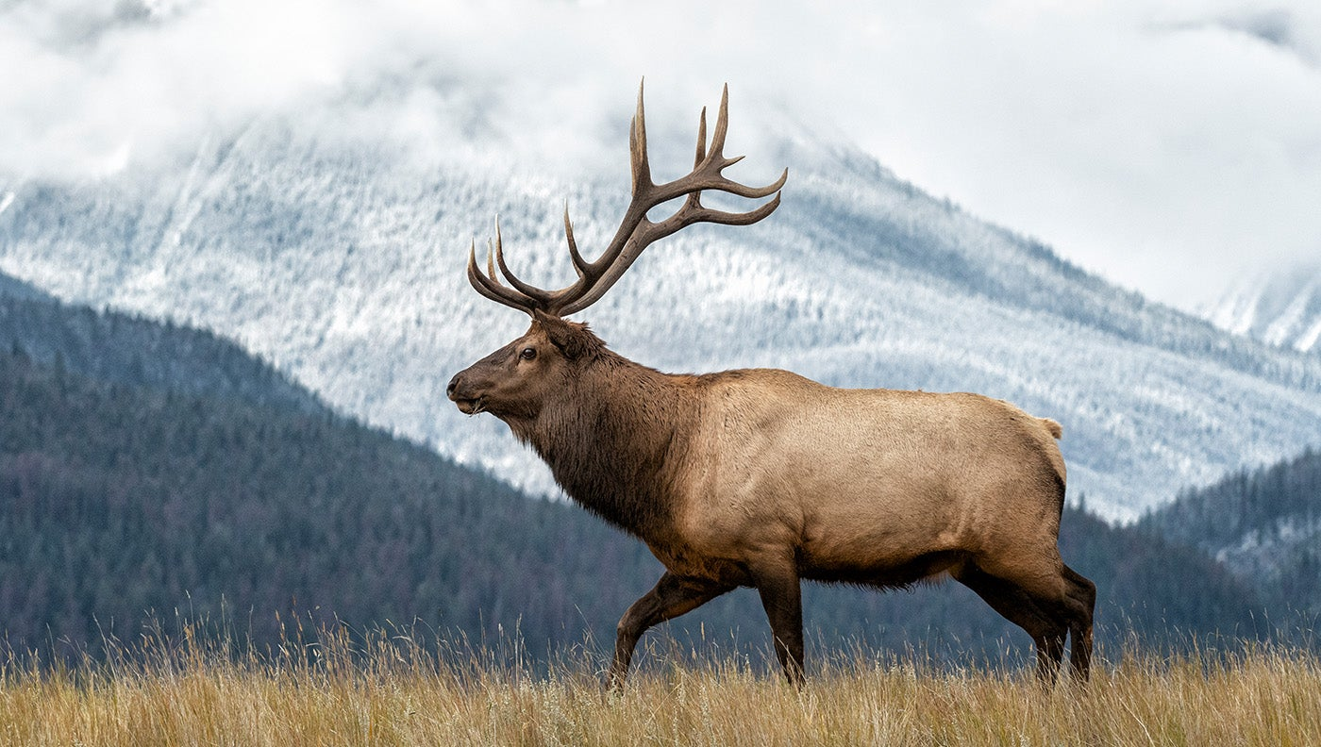
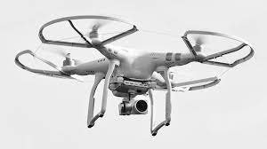
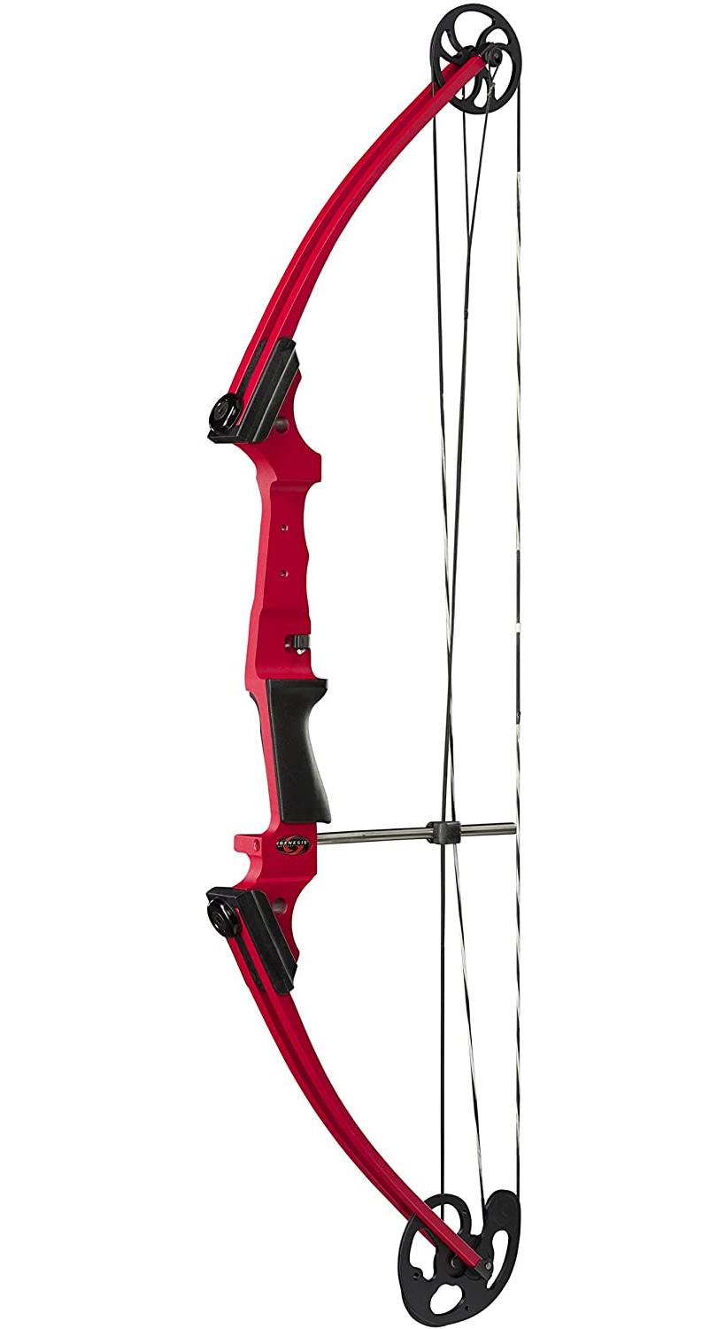
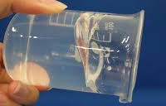
Research & Scholarly Innovation
Problem: You need to design a new system to deliver a CWD vaccine to elk. How will you do it?
Think outside the box
Don’t limit yourself by resources

Slide 3
Learning Objectives
Discuss why research and scholarly activity is important at RVU
Describe the RVU process for conducting research and scholarly activity
Identify resources for conducting research and scholarly activity
https://thepeakperformancecenter.com/business/learning/business-training/learning-objectives/
Overall Goal: Demystify research and scholarly activity
https://spencerauthor.com/taking-research-to-the-next-level-in-project-based-learning/

Slide 4
What is research?
Research is defined as a systematic investigation into a topic or material in order to establish facts and reach a conclusion.
Scholarly activity is defined as creative works that are peer reviewed and publically disseminated.

Slide 7
These are continuing to expand and change as our number of programs grows

Slide 8
Elevate RVU Research
Why?
Makes our students more competitive
Improve residency match
“Developing a stronger overall scientific reputation by contributing to major health care advances is the most critical factor in promoting osteopathic medicine.”
The Journal of the American Osteopathic Association, August 2014, Vol. 114, 608-614. doi:https://doi.org/10.7556/jaoa.2014.124

Slide 9
Specialty | Mean number of abstracts, presentations, and publications, US Senior (Matched) | Mean number of abstracts, presentations, and publications, US Senior (Unmatched) | Mean number of research experiences, US Senior (Matched) | Mean number of research experiences, US Senior (Unmatched)
Anesthesiology | 6.6 | 4.4 | 3.7 | 3.1
Child Neurology | 7.4 | 2.0 | 3.8 | 2.0
Dermatology | 20.9 | 15.7 | 7.2 | 6.1
Diagnostic Radiology | 8.0 | 7.2 | 4.6 | 3.8
Emergency Medicine | 5.1 | 2.7 | 3.2 | 2.0
Family Medicine | 4.1 | 2.6 | 2.4 | 1.9
General Surgery | 8.6 | 5.3 | 4.7 | 4.0
Internal Medicine | 6.9 | 3.5 | 3.6 | 2.8
Internal Medicine/Pediatrics | 6.5 | 5.5 | 3.5 | 2.8
Interventional Radiology | 12.2 | 7.2 | 5.5 | 3.8
Neurological Surgery | 25.5 | 11.7 | 6.6 | 5.9
Neurology | 7.8 | 7.6 | 3.9 | 3.8
Obstetrics and Gynecology | 6.8 | 5.0 | 4.4 | 3.6
Orthopaedic Surgery | 16.5 | 12.1 | 6.6 | 5.4
Otolaryngology | 17.2 | 11.0 | 7.3 | 6.5
Pathology | 8.5 | 1.7 | 3.4 | 3.0
Pediatrics | 5.6 | 5.9 | 3.2 | 2.4
Physical Medicine and Rehabilitation | 6.2 | 3.9 | 3.6 | 3.0
Plastic Surgery | 28.4 | 13.8 | 6.1 | 5.9
Psychiatry | 6.2 | 4.2 | 3.4 | 2.8
Radiation Oncology | 13.3 |  | 4.5
Vascular Surgery | 12.4 | 11.3 | 6.3 | 3.8
Data: 2022 Charting Outcomes in the Match reports (https://www.nrmp.org/match-data-analytics/residency-data-reports/)

Slide 10
Overall Process
Define the problem
Review the literature
Select a research design
Formulate a hypothesis
Obtain regulatory approvals
Carry out the research
Analyze the data
Report your findings

Slide 11
Find A Problem YOU Care About Ask yourself the following:
Why did you chose the career you did?
Why are you at RVU?
What problems are you/your friends/or your family facing? Can you help?
Start reading and get a good reference manager:
Pubmed/Google Scholar/Up to Date/ others
Zotero

Slide 12
Finding a topic
Brainstorm: Make a list of everything that interests you within a specific topic.
Using the first list, make a 2nd list of things you are capable of doing
Using the first list, make a 3rd list of all of the things (include resources, people, equipment, space, patient populations, etc.) that you need to accomplish your list
Prioritize your list
Don’t sell yourself short
Using the first list, make a 4th list of your ideas that are important to society, healthcare, or the profession.
Find your passion

Slide 13
Finding a topic
Compare your 4 lists:
Mark off the items on your merged list that are not feasible.
The topic that survives or is central to all other topics is the basis for your research question.
Begin a literature study of your chosen topic and set a timeline.
What items appear on each of your lists? Use these to create a single list
Remember that just because you do not pursue something at the time, does not mean that you can never do it.
Find your passion

Slide 14
Define your question/hypothesis
Make it brief
Make it clear (avoid the “and”)
Is it manageable?
What is the gap you are trying to fill?
How are you uniquely qualified to fill it?
Evaluate the Quality

Slide 15
Assess your Question and Experimental Design
https://csulb.libguides.com/nursing/pico
Notes:
Sometimes Time is included in this framework

Slide 16
Assess your Question and Experimental Design
https://guides.library.vcu.edu/rapidreview

Slide 17
Types of Experimental Designs

Slide 18
Types of Research Designs
All studies
Descriptive
Individual
Epidemiology study
Analytical
Interventional
Population
Case Study/Series
Cross-sectional (surveys)
Observational
Case control study
Cohort study
Clinical trials
Community intervention

Slide 19
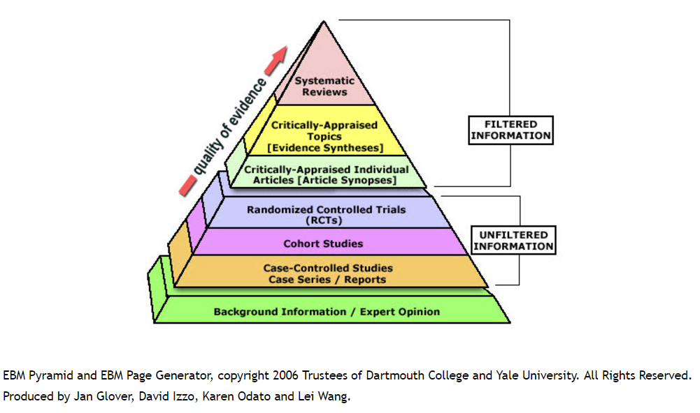
Levels of Evidence – Not all research is created equal
Quality of Evidence
≠
Quality of Research

Slide 20
Basic Principles
Formulate your hypothesis
Make sure that you can measure it
Randomize
Comparisons/controls
Stratification (blocking)
Factorial Experiments
Replicates

Slide 21
Replication
Power analysis
Relies on an expected effect size (based on literature or previous experiments). This may be unknown so you may have to pilot and then do a post hoc analysis
Why replicate?
Reduce the effect of uncontrolled variation
Quantify uncertainty
If you have a lot of uncontrolled variation, what will that do to your number of replicates?

Slide 22
Comparison/Control
Good experiments are comparative to controls
Compare infection and bone growth after 8 weeks in rabbits not provided the antibiotic releasing bone void filler – What question does this answer?
Compare infection and bone growth after 8 weeks in rabbits provided an antibiotic loaded bone void filler without the polymer control – What question does this answer?
Compare infection and bone growth after 8 weeks in rabbits not given the infection – What question does this answer?
Ideally, the experimental group is compared to concurrent controls (not historical ones)

Slide 23
Experimental Designs
Manipulation of variables to determine a cause and effect relationship
Randomized Controlled Trials (RCTs): Participants are randomly assigned to treatment and control groups to measure the effect of an intervention.
Quasi-Experimental Designs: Similar to RCTs but without random assignment, often used when randomization is impractical or unethical.
Nonequivalent Control Group Design
Interrupted Time Series Design
Pretest-Posttest Design
Factorial Designs: Investigate multiple factors simultaneously, testing all possible combinations of factor levels.
Crossover Designs: Participants receive multiple treatments in a sequence, acting as their own control.

Slide 24
Randomized Controlled Trial
https://www.simplypsychology.org/randomized-controlled-trial.html

Slide 25
Randomization
Experimental subjects should be assigned to treatment groups at random.
Why?
Avoid Bias – it is possible that the first 7 animals that were chosen are immunocompromised
Control the role of chance to provide a solid foundation for statistics
Control for learning the procedure
How?
Not haphazard
Use a computer
Coins, dice, cards
https://www.youtube.com/watch?v=_qepy1cmRDk

Slide 26
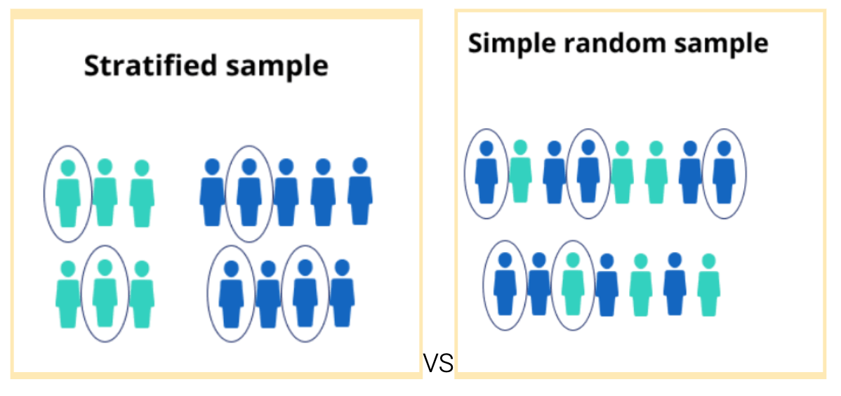
Stratification
Some surgeries were performed in the morning and some in the afternoon
What if time of day the surgery was performed makes a difference
Ensure that equal numbers are performed in each time period
Make sure the same number of treatment and controls are done in each time period
This may also be called blocking
When to randomize vs stratify:
If you can and you want to fix a variable (strain of animal, time of surgery, etc.)
If you don’t fix a variable then stratify it (you could also think about this as demographically matched controls)
If you can neither fix or stratify a variable, then randomize it.
Notes:
Stratified random sampling (also known as proportional random sampling and quota random sampling) is a probability sampling technique in which the total population is divided into homogenous groups (strata) to complete the sampling process.
Each stratum (the singular for strata) is formed based on shared attributes or characteristics — such as level of education, income and/or gender. Random samples are then selected from each stratum and can be compared against each other to reach specific conclusions.

Slide 27
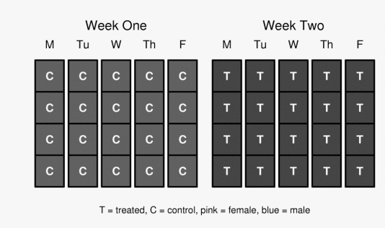
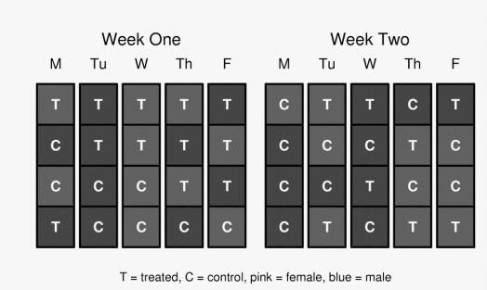
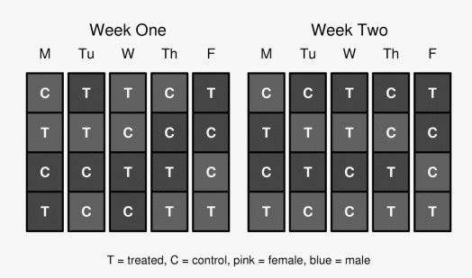
Bad Design or good design?
Bad design
Randomized design
Stratified design

Slide 28
Nonequivalent Pretest post test design
No randomization
Could introduce bias
https://www.researchgate.net/figure/Non-equivalent-control-group-pretest-posttest-design-422-The-One-Group-Pre-test_fig7_342878063

Slide 29
Interrupted Time Series Design
Analysis done during the study

Slide 30
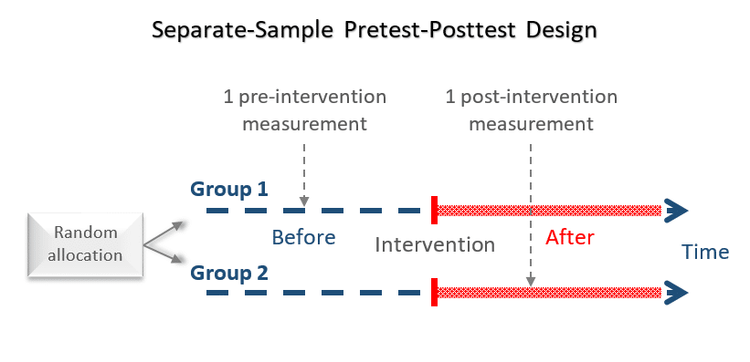
Pretest posttest Design
Multiple Groups
One Group

Slide 31
Factorial Design
https://conjointly.com/kb/factorial-designs/

Slide 32
Crossover Design
https://s4be.cochrane.org/blog/2020/09/07/crossover-trials-what-are-they-and-what-are-their-advantages-and-limitations/

Slide 33
Observational Designs
Observing and measuring variables without manipulating them
Cohort Studies: Follow a group of people over time to study the incidence and risk factors of a condition.
Prospective Cohort Studies: Follow participants forward in time from exposure to outcome.
Retrospective Cohort Studies: Look back at existing records to study exposures and outcomes.
Case-Control Studies: Compare individuals with a condition (cases) to those without it (controls) to identify risk factors.
Cross-Sectional Studies: Analyze data from a population at a single point in time to assess the prevalence of an outcome or characteristic.
Ecological Studies: Examine relationships between variables at the population or group level rather than individual level.

Slide 34
Prospective Cohort Design
https://www.simplypsychology.org/prospective-study.html

Slide 35
Retrospective Cohort study
https://sphweb.bumc.bu.edu/otlt/MPH-Modules/PH717-QuantCore/PH717-Module4-Cohort-RCT/PH717-Module4-Cohort-RCT5.html

Slide 36
Case Control Study Design
https://deakin.libguides.com/quantitative-study-designs/casecontrol

Slide 37
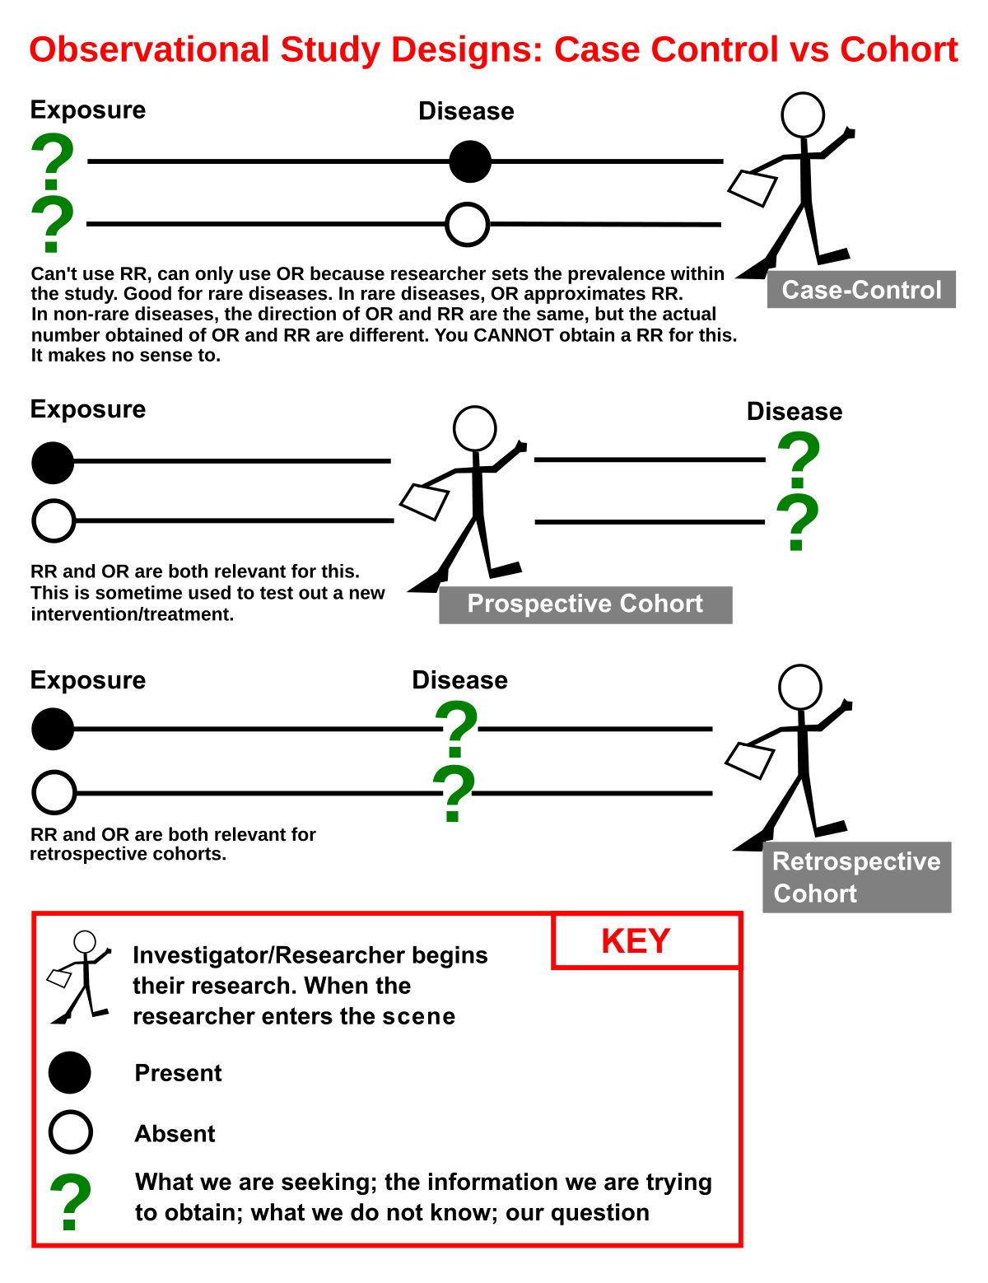
How to decide what kind of study?
Are your groups starting out the same?
Case control
A and O: Groups look different to start
Odds ratio
Only look backwards
Cohort study
O and O: Both groups are the same to start
Relative risk
Can look forward and backward
Can be prospective or retrospective

Slide 38
Cross-sectional Study Design
“The cross-sectional study is an observational study that assesses exposure and the outcome at one specific point in time in a sample population. There is no prospective or retrospective follow-up. Both the RR and the OR can be calculated to describe the association between the exposure and the outcome.”
“The cross-sectional study cannot be used to infer causality because a temporal sequence cannot be established.”
https://www.sciencedirect.com/topics/pharmacology-toxicology-and-pharmaceutical-science/cross-sectional-study

Slide 39
Ecological Study Design
https://www.sciencedirect.com/topics/pharmacology-toxicology-and-pharmaceutical-science/ecological-study

Slide 40
Descriptive Designs
Aim to describe characteristics or functions without assessing relationships
Case Reports and Case Series: Detailed reports of single or multiple cases, often used to describe rare conditions or novel treatments.
Descriptive Surveys: Collect data to describe characteristics, attitudes, or behaviors of a population.
Qualitative Studies: Explore complex phenomena through interviews, focus groups, or observations to gain in-depth understanding.

Slide 41
Case Reports/Case Series – Technically not Research
https://harrisonreedwriting.com/how-to-write-a-case-report/

Slide 42
Descriptive Surveys
https://www.educba.com/descriptive-research/

Slide 43
Qualitative studies
https://jcu.pressbooks.pub/intro-res-methods-health/chapter/4-3-qualitative-research-methodologies/

Slide 44
Analytical Designs
Assess associations between variables and often include both observational and experimental design elements
Very statistically driven
Correlation Studies: Investigate the relationship between two or more variables without inferring causation.
Regression Analysis: Examines the predictive relationship between dependent and independent variables.

Slide 45
Correlational Study Design
https://www.simplypsychology.org/correlation.html

Slide 46
Regression Analysis
https://www.investopedia.com/terms/r/regression.asp

Slide 47
Review Designs
Synthesize existing research to provide understanding of a topic
Systematic Reviews: Summarize and critically appraise research studies on a specific question using a rigorous methodology.
Meta-Analyses: Combine data from multiple studies to produce a pooled estimate of effect size.
Narrative Reviews: Provide a broad overview of a topic, often without a systematic approach to selecting studies.

Slide 48
https://unimelb.libguides.com/whichreview

Slide 49
Different Types of Reviews
Shepperd, Martin. (2013). Combining Evidence and Meta-analysis in Software Engineering. 10.1007/978-3-642-36054-1_2.

Slide 50
Mixed Methods Designs
Integrate both a Qualitative and Quantitative approach to provide a comprehensive analysis and more context
Convergent Parallel Design: Collects and analyzes quantitative and qualitative data separately but simultaneously, then compares the results.
Explanatory Sequential Design: Starts with quantitative data collection and analysis, followed by qualitative data to explain the quantitative results.
Exploratory Sequential Design: Begins with qualitative data collection and analysis, followed by quantitative data to test or generalize the qualitative findings.

Slide 51
Comparison of Mixed Methods Designs
https://catalyst.harvard.edu/community-engagement/mmr/

Slide 52
Developmental Designs
Study changes over time and development
Longitudinal Studies: Follow the same subjects over an extended period to observe changes and developments.
Cross-Sequential Studies: Combine cross-sectional and longitudinal approaches to study changes over time in different cohorts.

Slide 53
Comparison of Developmental Designs
https://www.questionpro.com/blog/cross-sectional-study-vs-longitudinal-study/
https://nobaproject.com/modules/research-methods-in-developmental-psychology

Slide 54
Longitudinal Study Design
https://helpfulprofessor.com/cross-sectional-study-advantages-and-disadvantages/

Slide 55
Cross-sequential Study Design
https://uxpajournal.org/cross-sequential-studying-long-term-user-experience/

Slide 56
How to decide what kind of study?
Are your groups starting out the same?
Case control
A and O: Groups look different to start
Odds ratio
Only look backwards
Cohort study
O and O: Both groups are the same to start
Relative risk
Can look forward and backward

Slide 57
Time can help you decide the proper design
https://www.nature.com/articles/6400436

Slide 58
Find Resources
Find people to help you: Build a network
Find money
Find space
Contact me if you are having trouble with these steps: abrooks@rvu.edu

Slide 59
List of RVU Resources for Research
Library Website
Research 101
Research Question
Research Resources
Information Retrieval
Information Resources
BMJ R to P
Academic Writing
Research Ethics
Research Search Engines
Healthcare Databases
And so much more!
Office of Research and Scholarly Activity Website
Mentor help
MyVista
Office of Research Link
Research Modules
Research Project Resources

Slide 60
MyVista

Slide 61
Characteristics of a good Mentor
Enthusiasm, passion, and positivity (inspiration and optimism)
Can these attributes be developed?
Celebrate
Sensitivity, compassion, and empathy
Listen, hear, and support
Appreciate individual differences
Remember not everyone wants to be you
Respect
Unselfishness
Availability
Balancing direction and self-direction
Give advice in the form of a suggestion or a prompting question
Take a risk: Provide opportunities for growth
Use your contacts
Don’t be afraid to be wrong or not know
Nurture creativity
Constructive criticism
Effective Mentor
Enthusiastic
Inspirational
Sensitivity
Appreciate diversity
Authentic
Advisor
Critique
Connector
Supportive
Ethical
Role model
Collaborative
This is a lot to balance, why would anyone want to be a mentor?
https://www.nature.com/articles/447791a
https://www.nap.edu/read/5789/chapter/2#2
Notes:
“Effective Mentoring has been linked to enhanced self-efficacy, persistence; research productivity, higher career satisfaction, and enhanced recruitment of underrepresented minorities into biomedical research related career pathways. At this stage in your career, you are likely both a mentor and a mentee.”

Slide 62
This is a partnership

Slide 63
Dr. Amanda Brooks, PhD
Vice Provost of Research and Scholarly Activity
abrooks@rvu.edu
Dr. Karma McKelvey, PhD
Assistant Director of RSA and Associate Professor of Public Health
kmckelvey@rvu.edu
Dr. Isain Zapata, PhD
Assistant Director of RSA and Associate Professor of Research and Statistics
izapata@rvu.edu
Dr. Benjamin Brooks, PhD
4th Year Research Clerkship Director/Integrify Expert
bbrooks@rvu.edu
Emily Cox
Sr. Research Coordinator
ecox@rvu.edu

Slide 65
You are well on your way… enjoy the journey

Slide 66
RVU Research Process

Slide 67
So, what kinds of research is most accessible/successful at RVU?
Case Reports
Literature Reviews
Surveys
Chart Reviews/Patient Databases
Clinical Trials/Cohort Studies
Opinion Pieces/Commentaries
Grand Rounds
Journal Club

Slide 68
Explore
Refine
Work
Meet with Research Coordinator/Member of the RSA Office
Meet with Librarian/Statistician
Come Prepared:
Whole team, including mentor
Have at least 5 keywords
Have an outline
Have at least 5 Resources you have looked at
Can skip this if you already have an idea
Literature Review
Request a Distiller SR License
Develop a Study Design
Consult with a Statistician
IRB application if necessary
Request preliminary review from the Office of Research
Write an Outline
Review the Literature
Engage a Mentor
If students have not done all the steps to explore their ideas send them back to the research office
Identify a Research Team
Create a Research Project
All students start here
Research Interest form
Input your specialty and/or research interest
Consider available resources
MyVista
Survey the literature
Research Modules
CITI Training
Zotero
Research 101
BMJ R to P
Talk with peers and mentors
Review Professional Organization Websites
Shop the RVU Marketplace
All students should read at least 5 papers on the topic
Students who have not done research spend time here
If you have no ideas start here

Slide 69
RVU Research Hub and Marketplace

Slide 70
How to login
Use your RVU credentials

Slide 71
Are you a student, faculty, or staff?
Students click here
Faculty and Staff click here

Slide 72
Get registered in the system
1. Add your specialties of interest and any ideas you might have

Slide 73
Register your interests
Notes:
All the fields with an * are required.
Use the pull down menus where available.
You can update this as many times as you want
This will allow emails to be sent to a group with a designated specialty of interest to notify them of open projects.
Submit your form
Request a meeting to discuss ideas via navigate with a member of the research staff or other potential mentor

Slide 74
Get registered in the system
2. Outline your Project

Slide 75
Get registered in the system
2. Request Credit

Slide 76
Using the Research Marketplace
Notes:
Use the research marketplace to find open projects in your specialty of interest

