Slide 1
CV WRITING WORKSHOP
Career & Professional Development Team
Jeddie Herndon: jherndon@rvu.edu
Emir Karaketir: ekaraketir@rvu.edu

Slide 2
Agenda
Resume & CVs
5 C's of CV Writing
Sections to Include & Consider
Example Sections
CV Advice
Next Steps: What Now?

Slide 3
What's a resume?
Summarizes your experiences
Meaning: “résumé” is a French word that means “to sum up.”
Length: The ideal resume is one page
Purpose: Specific job or jobs
Structure: Structured chronologically by job, not categorially

Slide 4
What's a CV?
Details your professional career
Meaning: “Curriculum Vitae” means “course of life” in Latin
Length: No page length
Purpose: Applications for: Academic, Medical fields, Grants, & Awards
Structure: Structured categorically, chronological within the categories; not structured by job

Slide 5
LET'S BUILD A CV TOGETHER

Slide 6
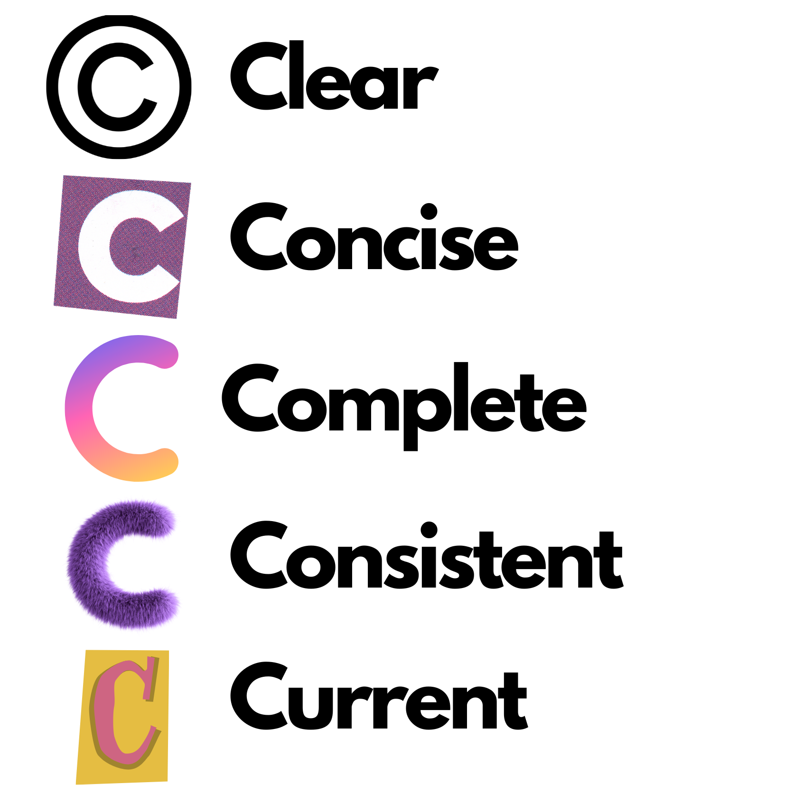
The 5 C's of CV Writing
SOMA, CV Writing 101​

Slide 7
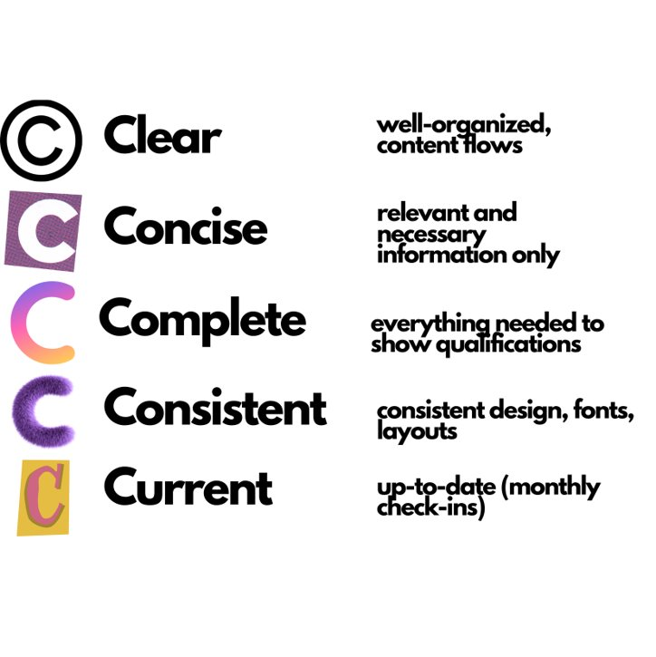
The 5 C's of CV Writing
SOMA, CV Writing 101

Slide 8
SECTIONS TO CONSIDER
Contact Information
Education
Healthcare Experience
Professional Memberships
Leadership
Research
Certifications
Co-Curricular Activity
Trainings/Workshops
Awards/Recognitions
Volunteering
Hobbies/Interests

Slide 9
SECTIONS TO CONSIDER
Contact Information: Name, Email, LinkedIn, ePortfolio
Education: Undergraduate, Graduate, RVU
Healthcare Experience: CNA, RN, EMT, Clinical Experience, Medical Sales
Professional Memberships: AACOM, ACOG, SOMA, AOA
Leadership: Club leadership, Coaching Experience
Research: Published papers, poster presentations, paper presentations, conference presentation

Slide 10
SECTIONS TO CONSIDER
Certifications: ACLS, HIPPA, Wilderness First Responder, CPR, EMT
Co-Curricular Activity: On-Campus Clubs and Orgs
Trainings/Workshops: QPR, Narcan, Trauma Informed Care
Awards/Recognitions: T.O.U.C.H, Honors, Scholarships, School Awards
Volunteering: Community Outreach, Community Service
Hobbies/Interests: Hiking, reading, skiing, baking, learning a language

Slide 11
EDUCATION

Slide 12
HEALTHCARE EXPERIENCE

Slide 13
PROFESSIONAL MEMBERSHIPS

Slide 14
LEADERSHIP EXPERIENCE

Slide 15
RESEARCH

Slide 16
CERTIFICATIONS

Slide 17
CO-CURRICULAR

Slide 18
TRAININGS & WORKSHOPS

Slide 19
AWARDS & RECOGNITION

Slide 20
VOLUNTEERING

Slide 21
HOBBIES & INTERESTS

Slide 22
Remember: the goal of writing a CV is to provide the reader with a well-organized overview of your major academic and extracurricular achievements.
Think broadly about everything you have done during college and afterwards, and what skills you can bring to medical school.
If you are uncertain about including something, ask yourself:
Will this information help me get selected for an interview?
Would I find this information relevant if I were an admissions reader of my CV?
If the answer to these questions is yes, include it. Otherwise, leave it out.
Remember the importance of formatting. It’s easier to read a CV that is organized.
Education should always come first.
Let your strengths guide you on organizing the rest of the document
research, honors, awards, word experience, or volunteer work.

Slide 23
Do’s
Create a “Master Copy” that includes EVERYHTING
Copy & paste the relevant info into a new document and modify it for each application
List everything in reverse chronological order
Optimize for applicant tracking systems-ATS
To ensure your document makes it past the ATS and into the hands of a human, keep your formatting simple. Include the right keywords without going overboard, read the description this will help tell you what the right keywords to include are.

Slide 24
Do’s
Align your dates and locations to the right
This small change will make your resume way easier on the eyes.
Highlight your most relevant experiences
Make it easy for the reader to see why you’re the right fit.
Keep your e-mail address professional
Unprofessional email addresses: mylittleponylover86@email.com partyboyz239@email.com
GOOD email addresses: MaryDoe@email.com M.Martin@email.com

Slide 25
Do’s
If you decide to use bullets, don’t use more than 3 lines per bullet
The eyes and brain react better to odd numbers.
Use powerful verbs
Skip the tired and all-too-frequently used “led,” “handled,” and “managed,” and go for verbs like “charted,” “administered,” “consolidated,” or “maximized,” which make you look both confident and competent.
Use a thesaurus and don’t repeat words!
Be able to discuss anything listed on the CV for 5 minutes
If you only volunteered once or twice at an organization and can’t remember what you did there, do not list the activity!
Always think quality over quantity!

Slide 26
Don’ts
Don’t include “References Upon Request”
Don’t use clichés or jargon like “hard worker, team player, detailed oriented”.
Don’t include anything that could be discriminated against:
While it’s illegal to discriminate against a candidate because of his or her age, marital status, gender, religion, race, color, or national origin, it doesn’t mean it doesn’t happen subconsciously.

Slide 27
Do’s
Use digits
Because 4 and 22% take less time to read than “four” and “twenty-two percent.” Plus, using digits saves you space, and numbers make your experience seem more concrete.
Always have multiple readers review your CV and listen to their feedback!
Edit, edit, edit.
Thoroughly edit your document and make sure there are no spelling or grammatical errors.

Slide 28
Don’ts
Don’t use too many bullets or go overboard with text effects:
If every other word is bolded, italicized, or in ALL CAPS, it will be distracting and annoying.
Use emphasis sparingly, for your most important info.
Don’t use more than 2 fonts!
Don’t Include random, unrelated, or off-putting hobbies

Slide 29
Don’ts
Don’t lie or exaggerate
Don’t include things from High School.
High School is too far back.
Unless you received a very well-known award (such as Eagle Scout), it is inappropriate to list high school activities.
Don’t forget to spell check.

Slide 30
Don’ts
Don’t send it as a word document
Convert it to PDF, print it, and check for inconsistencies like extra spaces.
Sending your resume or CV off as a word document file will most likely result in all of this careful formatting getting messed up when the reader opens the file.
Save your final version as a PDF to make sure everything stays just as is.
Send it to yourself before you send it to anyone else!

Slide 31
See you at your Career Advising appointment!

