Slide 1
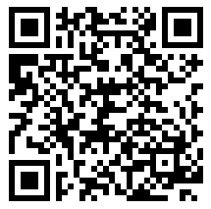
Pre-survey: Please complete before we start.
Thank you!
Notes:
NEED TO CHANGE THE QR CODE

Slide 2
IRB 101 & COMMON IRB MISTAKES
Dr. Amanda Brooks and Dr. Jennifer Hellier

Slide 3
OBJECTIVES
Describe the creation and function of an institutional review board (IRB)
Describe the different types of IRB approval needed for research studies
Gain confidence in preparing and mentoring IRB Applications
Make IRB approval faster and easier

Slide 4
INSTITUTIONAL REVIEW BOARD (IRB)
IRBs must review all projects that meet the definition of research and that involve human subjects PRIOR to any data collection. ​
IRB determines the appropriate level of review: exempt, expeditated, or full-board.​
IRB members have completed additional certification and must ensure applications/human subject research protocols follow federal laws​
Notes:
Federal Regulations define research as “a systematic investigation, including development, testing, and. evaluation, designed to develop or contribute to generalizable knowledge¹ ” (45CFR46.102(d)).

Slide 5
TYPES OF IRB REVIEW
EXEMPT
EXPEDITED
FULL
exempt from the specific regulations and requirements in Title 45, Part 46 of the Code of Federal Regulations
EXAMPLES:
Surveys/Interviews with no PPI​
Minimal Risk​
Educational practices​
no more than minimal risk but which do not meet any of the criteria for exempt status​​
EXAMPLES: ​
Digital data collection​
Noninvasive procedures routinely employed in clinical practice​
​
research that does not qualify for Exempt or Expedited Review as previously defined​
EXAMPLES:
More than minimal risk​
Vulnerable populations​
Psychological stress​
Notes:
PPI​ (protected personal info)

Slide 6
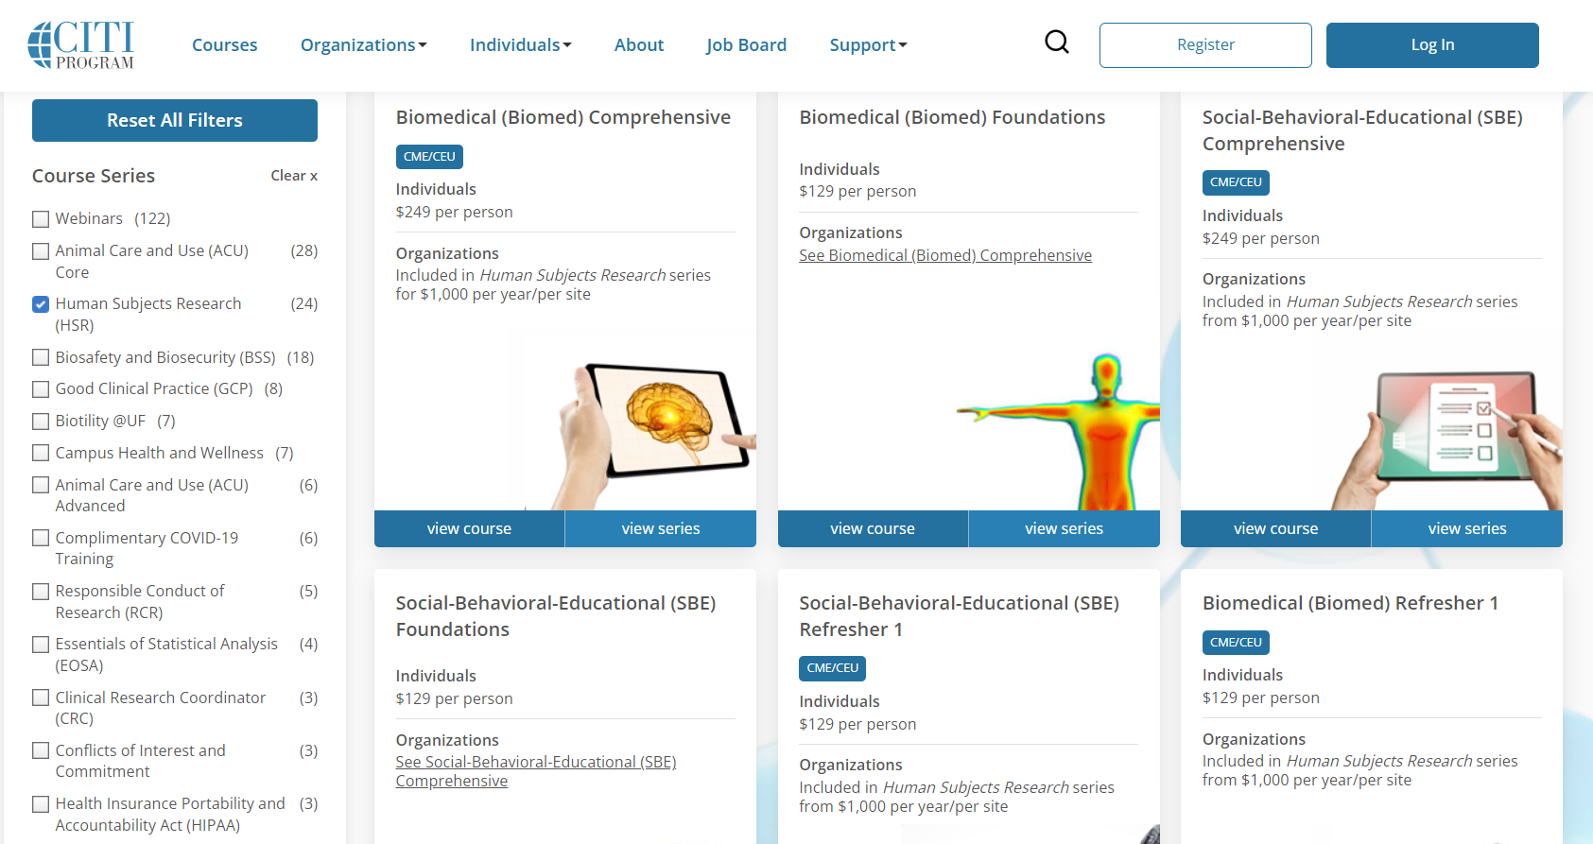
Contact Laura Dement (ldement@rvu.edu) for specific instructions and what
certifications are needed

Slide 7
Link to IRB website, detailed instructions, etc.

Slide 8
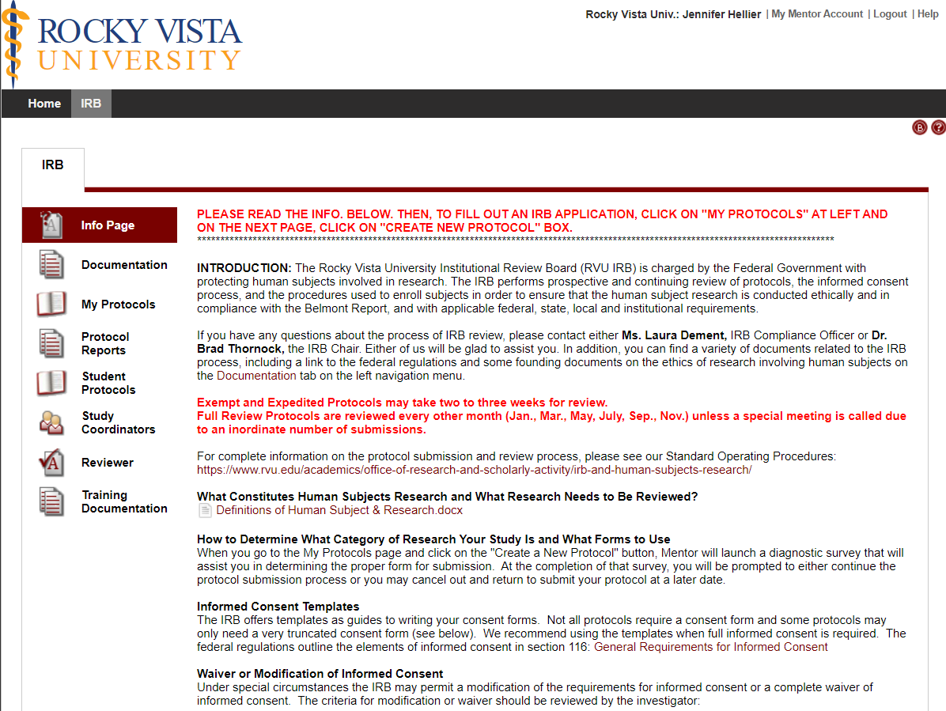
Consent form templates, RVU Institutional Data Requests, etc.
Click here to start an IRB application.
OPTIONAL: upload your CITI training certificates here.

Slide 9
SURVEY BEST PRACTICES
Set up concrete project objectives
Check for validated surveys
Make every question count
Plan the order of questions
Limit survey length and question complexity
How to word the question/statement
Keep it simple for respondents
Watch Survey Bootcamp Recording

Slide 10
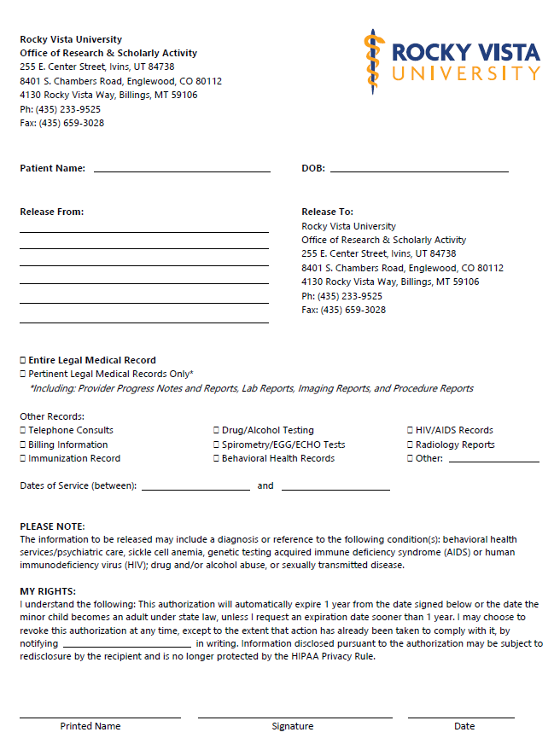
MEDICAL RECORD RELEASE
AFTER IRB approval
Need consent information (~8th grade reading level; Flesch Reading Ease Score; Flesch-Kincaid Grade Level)
Even if a family member!
Behind TWO locks
Encrypted digital file
Link to RVU's Research Hub for form

Slide 11
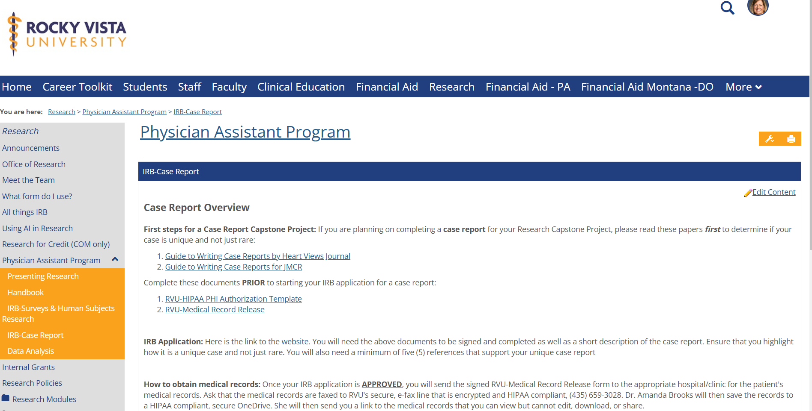

Slide 12
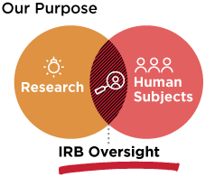
1
RESEARCH THAT REQUIRES IRB REVIEW
All research involving human subjects or biospecimens must be approved by an IRB (Institutional Review Board)
Definition of a Human Subject:
Living Individuals and/or their biospecimens about whom information is obtained through intervention
Or interaction or interpersonal contact and investigator uses, studies, or analyzes the information or biospecimens
IRB Oversight
Notes:
Healthcare insurance example.

Slide 13
Notes:
Poll Title: Do not modify the notes in this section to avoid tampering with the Poll Everywhere activity. More info at polleverywhere.com/support I need an IRB for a retrospective chart review https://www.polleverywhere.com/multiple_choice_polls/hrAkRX4X8e2pglITSuKbM?state=opened&flow=Default&onscreen=persist

Slide 14
Notes:
Poll Title: Do not modify the notes in this section to avoid tampering with the Poll Everywhere activity. More info at polleverywhere.com/support I need an IRB for a case report https://www.polleverywhere.com/multiple_choice_polls/nnthvIU2EqZuWZAqCLsXD?state=opened&flow=Default&onscreen=persist

Slide 15
Notes:
Poll Title: Do not modify the notes in this section to avoid tampering with the Poll Everywhere activity. More info at polleverywhere.com/support I need an IRB for a literature review https://www.polleverywhere.com/multiple_choice_polls/X13aL5qF3dCCn0UxaFOVJ?state=opened&flow=Default&onscreen=persist

Slide 16
Notes:
Poll Title: Do not modify the notes in this section to avoid tampering with the Poll Everywhere activity. More info at polleverywhere.com/support I need an IRB to conduct a survey to improve my teaching https://www.polleverywhere.com/multiple_choice_polls/kW2orzwy49lZEuaurjAWa?state=opened&flow=Default&onscreen=persist

Slide 17
Notes:
Poll Title: Do not modify the notes in this section to avoid tampering with the Poll Everywhere activity. More info at polleverywhere.com/support I need an IRB to conduct a survey of my students for educational research https://www.polleverywhere.com/multiple_choice_polls/kqeZBzo8lFjPqsLyHPuZ1?state=opened&flow=Default&onscreen=persist

Slide 18
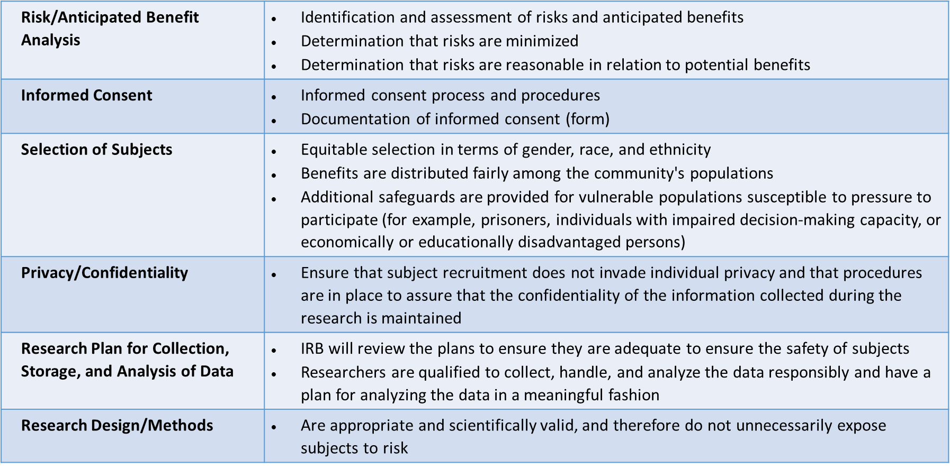
WHAT WILL THE IRB CONSIDER IN ITS REVIEW?

Slide 19
2
ROLES & RESPONSIBILITIES
PRINCIPAL INVESTIGATOR
FACULTY/PRECEPTOR MENTOR
Design the experiment
Write the protocol
Integrity of the research
Conduct of the research
Manage collaborators and contributors
Report adverse events
Complete reports
Provide input on experimental design to ensure good practices
Review the protocol
Ensure integrity in the conduct of the research
Manage collaborators and contributors
Ensure adverse events are reported
Approve all reports

Slide 20
3
MOST COMMON MISTAKES
Not using the correct Informed Consent form/template.
Not enough support for the research in the “background and significance” section under project details.
Lack of a robust literature review (minimum 5-10 sources).
Mistakes in grammar and punctuation drive the reviewers crazy!
Missing a thorough explanation of how the privacy and confidentiality of the subjects will be protected, stored, and retained.
Lack of Risk/Benefit analysis.
Permission/authorization to use data.

Slide 21
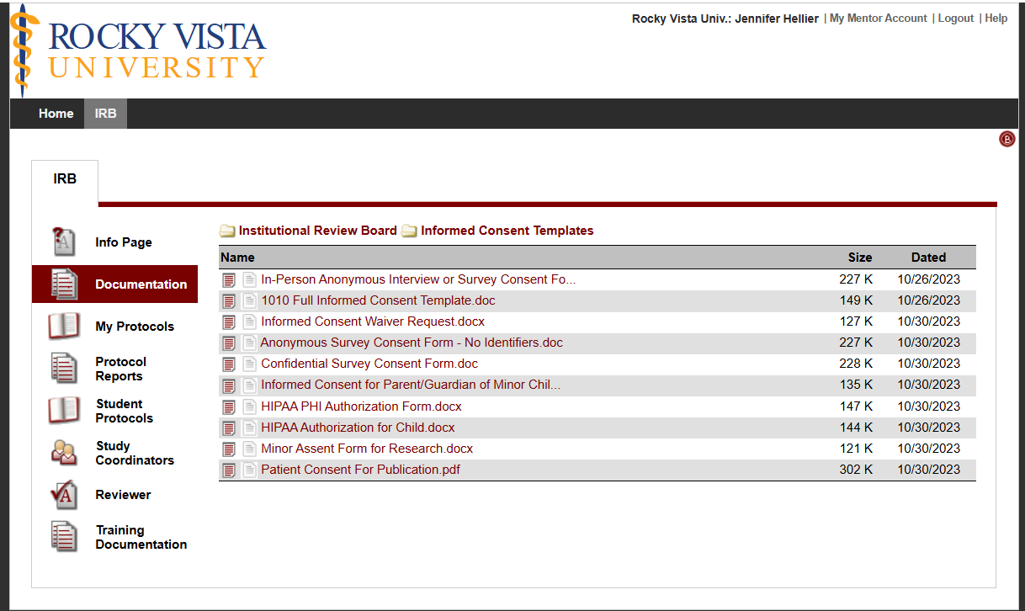
4
CONSENT FORMS
List of forms and when to use
When to request a waiver/what does it mean?
Case reports not using any identifying information,
secondary research,
retrospective chart review (already de-identified), or
not pulling any identifying data
PHI – what is classified as identifying?
Notes:
PHI can be:
1. Names; 2. All geographical subdivisions smaller than a State, including street address, city, county, precinct, zip code, and their equivalent geocodes, except for the initial three digits of a zip code, if according to the current publicly available data from the Bureau of the Census: (1) The geographic unit formed by combining all zip codes with the same three initial digits contains more than 20,000 people; and (2) The initial three digits of a zip code for all such geographic units containing 20,000 or fewer people is changed to 000. 3. All elements of dates (except year) for dates directly related to an individual, including birth date, admission date, discharge date, date of death; and all ages over 89 and all elements of dates (including year) indicative of such age, except that such ages and elements may be aggregated into a single category of age 90 or older; 4. Phone numbers; 5. Fax numbers; 6. Electronic mail addresses; 7. Social Security numbers; 8. Medical record numbers; 9. Health plan beneficiary numbers; 10. Account numbers; 11. Certificate/license numbers; 12. Vehicle identifiers and serial numbers, including license plate numbers; 13. Device identifiers and serial numbers; 14. Web Universal Resource Locators (URLs); 15. Internet Protocol (IP) address numbers; 16. Biometric identifiers, including finger and voice prints; 17. Full face photographic images and any comparable images; and 18. Any other unique identifying number, characteristic, or code (note this does not mean the unique code assigned by the investigator to code the data)

Slide 22
Protected Health Information (PHI)
What is considered PHI?
Notes:
Poll Title: Do not modify the notes in this section to avoid tampering with the Poll Everywhere activity. More info at polleverywhere.com/support What information is included in Protected Health Information (PHI)? https://www.polleverywhere.com/free_text_polls/CZKlL7di5LZC22jI2uqEo

Slide 23
5
BACKGROUND & SIGNIFICANCE
Not enough support for the research in the “background and significance” section under project details.
What is currently known?
What is still unknown?
What is your research hypothesis/aim/objective to address the unknown?
Minimum 4-5 references
Justify why you are doing the study

Slide 24
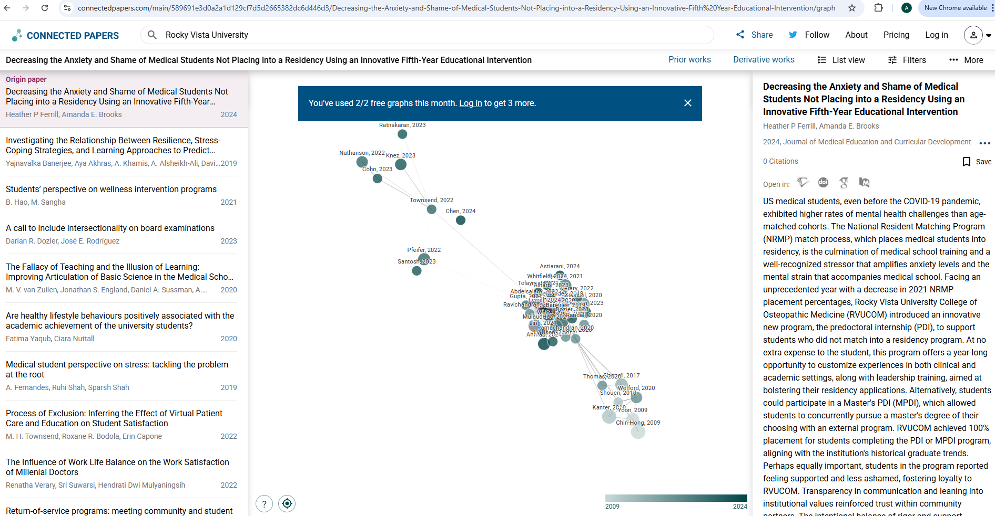
6
LITERATURE REVIEW
Minimum of 5-10 references
If you don’t have any literature, then find surrounding and supporting papers to make connections
Tools
connectedpapers.com
JANE

Slide 25
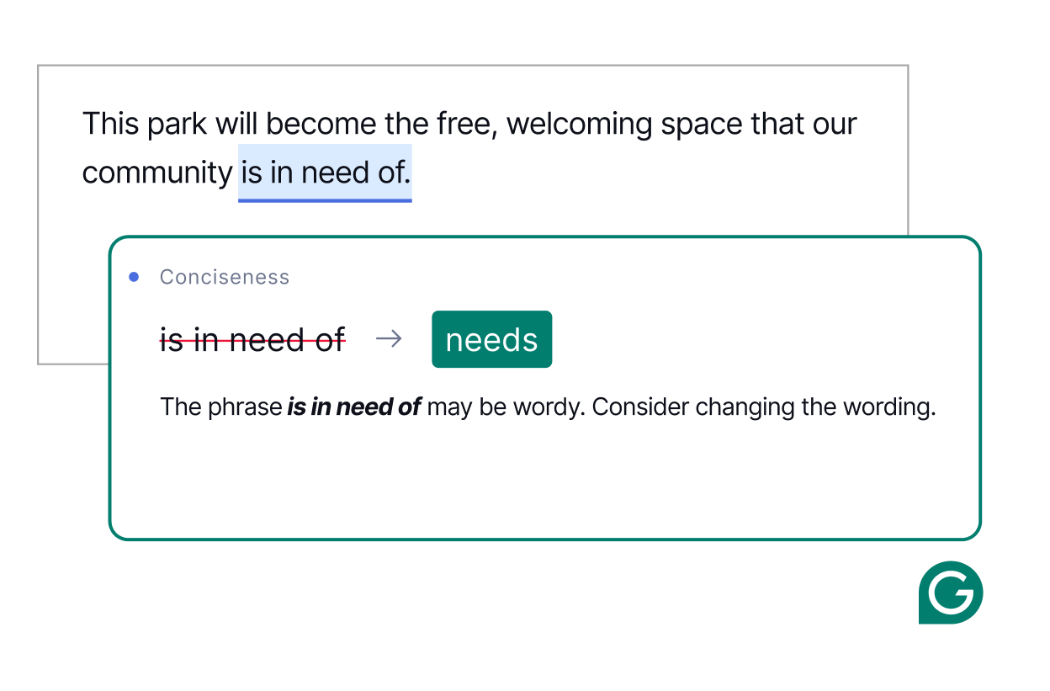
7
GRAMMAR MISTAKES
Mistakes in grammar and punctuation drive the reviewers crazy!
Axiom Mentor tools
Strategies for editing
Mentor responsibility

Slide 26
8
DATA SECURITY & PRIVACY PROTECTION
A thorough explanation of how the privacy and confidentiality of the subjects will be protected.
Data storage/protection and data retention policy
Explanation should be thorough about the method of de-identification
Risk/Benefit Analysis

Slide 27
9
PERMISSION TO USE DATA
Permission/authorization to use data
Institutional data use request (testing information)
Use of data from the practitioner’s office/hospital (can be emailed with the official’s signature)

Slide 28
OTHER IMPORTANT DOCUMENTS
Conflict of Interest Declaration
Copies of Surveys, Study Materials, Data Collection Tools, Permission to Use Data, Medications or Medical Instruments Being Used, etc.
Export your survey from Qualtrics
Subject Recruitment Materials (ads, flyers, questionnaires, email, etc.)
Any Other Correspondence Related to the Research Protocol (e.g., Clinical Trial Protocol, FDA Device or Drug Approvals, Investigator’s Brochure, Sponsoring Entity, Grant Proposals, etc.)
Agreement for an Outside Institution to Rely on RVU’s IRB or Agreement for RVU Students or Faculty to Rely on an Outside IRB (if applicable)

Slide 29
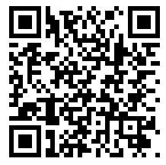
Post-survey: Please complete today!
Thank you!
Notes:
NEED TO CHANGE THE QR CODE

