Slide 1
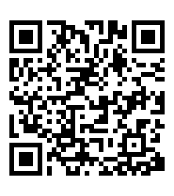
Pre-survey: Please complete before we start.
Thank you!

Slide 2
Creating a Poster/Presentation Workshop
Drs. Amanda Brooks, Jennifer Hellier, and Karma McKelvey

Slide 3
WHO IS YOUR AUDIENCE?
What do they know? Experts? Novices?
How much time do you have for your presentation?
How much time do they have to read your poster?
Does your audience have decent vision?

Slide 4
WHAT TO INCLUDE
title
author*
abstract/overview
background / introduction
methods used
results (4-6 high-resolution figures and/or tables)
discussion/conclusions
references
acknowledgements (i.e., funding, participants, etc.)
Surprisingly, I have seen this missing!
https://ohiostate.pressbooks.pub/scientificposterguide/chapter/scientific-posters/
Notes:
Characteristics of a Scientific Poster
Organized, clean, simple design.
Focused on one specific research topic that can be explained in 5-15 minutes.
Contains a Title, Authors, Abstract, Introduction, Materials & Methods, Results, Discussion, References and Acknowledgements.
Has four to 6 high-resolution figures and/or tables that describe the research in detail.
Contains minimal text, with figures and tables being the main focus.

Slide 5
WHAT NOT TO INCLUDE OR DO
TOO MUCH information (e.g., loads of text)
too small of text
low-resolution figures
names of participants (or other HPI)
poor contrast between background and text
link = what to include in your abstract. https://www.ncbi.nlm.nih.gov/pmc/articles/PMC1082941/
Notes:
Make it easy for your audience so don’t do the following:
TOO MUCH information (e.g., loads of text)
too small of text
low-resolution figures
names of participants (or other HPI)
poor contrast between background and text
The next set of slides include the 6 steps to an excellent poster.

Slide 6
1
MAKE IT EASY TO READ
use bullet points (no need for full sentences)
justify your text to the left
pictures = 1000 words
don’t surround images/diagrams with large blocks of text
Notes:
Step one: make it easy to read for your audience.

Slide 7
2
MAKE A STORY
structure is important
logical order from LEFT to RIGHT and TOP to BOTTOM
separate your story into three or four columns
make a clear START to FINISH flow
Notes:
Step 2: make a story that flows and not jumps from one part of the poster to another.

Slide 8
3
BREATHING SPACE
allow for negative space
too much information = cluttered
~40% of the poster should have “white space” or be blank
use space strategically → for the most important info (the figures and tables)
Notes:
Step 3: allow your poster to breathe! Meaning don’t be afraid of negative space.

Slide 9
4
RIGHT COLOR PALETTE
color = makes your story come to life
only use 3-5 colors
avoid too bright of colors & those that print poorly
background pictures/patterns can be distracting
dark backgrounds do not print well
keep it simple
Notes:
Step 4: choose a color palette that has high contrast from your background

Slide 10
5
FONT SIZE & STYLE MATTER
general rule: everything should be visible from 6’ away
text should be 24 points or larger
use one font style for the body and another for titles
use a professional font (e.g., no comic sans)
body = serif fonts (e.g., Times New Roman)
titles/headings = non-serif fonts (e.g., Arial)
Notes:
Step 5: Font style and size matter!

Slide 11
6
LAST BITS
think of a concise, interesting title to draw visitors
re-figure your figures
add arrows to your figures to help your readers understand what is important
add titles with more general words for non-experts
include a summary figure for those passing by or who have little time to read
use a QR code for the references or only include the most important references on your poster (in a small font)
Notes:
Step 6: Last items to remember. Your title and abstract should attract visitors, thus, make them easy to understand.

Slide 12
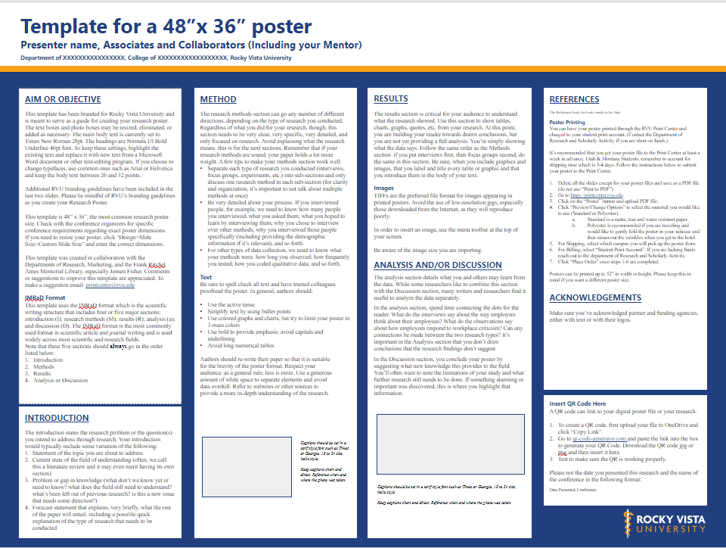
link to RVU template
Notes:
Here is the template for your use that was created by RVU’s Print Services. The text within this template, tells you what should be included.
You can find it on the Print Center’s Website. I personally prefer just three columns so that it doesn’t look cluttered. I suggest merging the middle two columns into one for visual appearance.

Slide 13
 | Very Poor (1) | Poor (2) | Average (3) | Good (4) | Excellent (5)
Content
Legibility | The poster is too small to read. | There is too much text and it is difficult to focus. | There are different sizes and font styles throughout the poster. | Figure captions/legend are difficult to read, but everything else is readable. | Poster can be read from 3 feet away and the size and style of the font are consistent. (Exception for references and acknowledgements)
Grammar | Grammatical mistakes are distracting and make it difficult to understand the writing. | Grammatical mistakes are abundant but the text is still understandable | Grammatical mistakes are minimal, but the jargon and sentence structure make it difficult to understand. | The definition of some acronyms are missing, but the jargon used is minimal and the test is understandable | No errors in spelling, punctuation, and grammar. It is easy to read.
Title | The title is misleading | The title does not reflect the work being done | The title is confusing but accurately describes the work | The title is overly wordy but accurate | Effectively Highlights the subject matter and accurately represents the content of the poster
Background | No background is provided. | Not all the relevant background is provided. | Background is relevant but not well referenced. | Background is relevant and mostly referenced, but some key concepts that provide justification for the work are missing. | Relevant previous work is referenced, acronyms and jargon are well explained and all important information is included.
Hypothesis or Research Question | No hypothesis/research question is provided | Hypothesis/research question is unclear or inferred. Hypothesis/research question may not be able to be measured/answered | Hypothesis/research question is leading or not well written | The hypothesis/research question is well written but the scientific premise supporting it is not clear. | The purpose of the study is clearly stated and supported by a solid scientific premise as established in the background.
Methods | Missing | Methods used are not appropriate to address the hypothesis/research question | Methods not complete (usually the analysis method is missing) | Methods are completed but either too much or too little detail is provided. | All procedures, including literature searches, and analysis are described in appropriate detail. A figure is used
Results | Results/expected results are not provided or discussed | Results/expected results are not provided but are contemplated briefly. | Results/expected are buried in the text of the poster | Results/expected results are provided as bullet points. | Results are easy to identify on the poster and provide an adequate summary of findings. Analysis is provided as figures
Figures and Figure captions | There are no figures or tables or figures are not referenced or used with permission. | Figure captions are missing and figures are not referenced in the text of the poster. | Figures do not support the story of the poster | The text of the poster does not reference the figures, but the captions are clear | Communicates facts and findings with a clear description to interpret the main take home messages.
Discussion/Conclusions | Missing | Results/expected results do not (will not) support the discussion/conclusion | Results are over interpreted in the discussion/conclusions. | Discussion/conclusions are supported by the results but not placed in the context of the field. | Evidence of critical thinking and ability to place findings I the context of the literature. Conclusions are supported by the data.
Future Directions | Missing | Vague and not specific to a field. | Future directions are suggested but may not be supported by the current study. | Future Directions are suggested and supported by the findings. The Impact on the field is considered | Future Directions are suggested and supported by the findings. The Impact on the field is considered and specific
Acknowledgements and References | Missing | References are provided but they are not complete or use many different citation styles. | Acknowledgements are not provided. | All figures and content are appropriately referenced and permissions obtained when necessary. Any contributions not rising to the level of authorship are acknowledged. | All figures and content are appropriately referenced and permissions obtained when necessary. Any contributions not rising to the level of authorship are acknowledged. Funding is acknowledged where appropriate and conflict of interest is mentioned.
Notes:
Here is the Rubric for evaluating RVU’s Annual Research Day poster. Continued on the next slide.

Slide 14
Presentation
Presentation of Material | No presenter present | Presenter did not practice and is not confident in what they are saying | Presenter stubbles over their words. | Presenter is well-rehearsed but not confident | Well-rehearsed, clear and confident
Understanding | No understanding of the material. | Significant gaps in understanding that prevent discussion. | Presenter can answer questions that were prepared but cannot have an in-depth conversation about the work. | Presenter has a relatively good understanding of the work they did but cannot extend it to the context of the field. | Understands the material well enough to answer questions and have an in-depth discussion, including implications to the field.
Enthusiasm and Engagement | Presenter is openly hostile toward the topic or the research team. | Presenter is not engaged in the topic and not happy to be there presenting. | Presenter is happy to be there but not necessarily excited about the topic and does not engage with the audience and allow time for questions. | Presenter is so excited about the topic that they do not allow the audience to ask any questions. | Excited/Passionate about the topic. Ability to engage the audience and get them to ask questions
Role in the project | There is no mentor listed on the project. | Presenter had no role on the project and does not understand the work | The presenter did not help carry out the work but understand it. | Everyone, including the presenter, had a clear role on the project. | Presenter acknowledges and makes clear everyone’s individual contributions during their presentation.
Notes:
Here is the Rubric for evaluating RVU’s Annual Research Day posters.

Slide 15
ORAL PRESENTATION
How long do you have?
Generally, 15 min to present the salient points with 5 min for questions & answers
Notes:
Congratulations, your paper is accepted in the research conference! Now what!?! Here are the three steps to help you organize your oral presentation.

Slide 16
1
OPENING (4 minutes)
self-introduction: name, affiliation, title (1 min)
research introduction (3 min)
title of talk
statement of problem
objectives
scope & limitations

Slide 17
2
MAKE A STORY (10 minutes)
research design and methods (4 min)
sources of data & research instrumentation
how data were gathered & analyzed
results, conclusions, and recommendations/next steps (6 min)
data represented in tables, graphs, and images
take home message

Slide 18
3
CONCLUSION (1 minute)
end your presentation (1 min)
restate the impact of your study
acknowledge key contributors and funders
provide references
thank organizers, other authors, audience for attention
open the floor to questions

Slide 19
EVALUATE POSTER #1

Slide 20
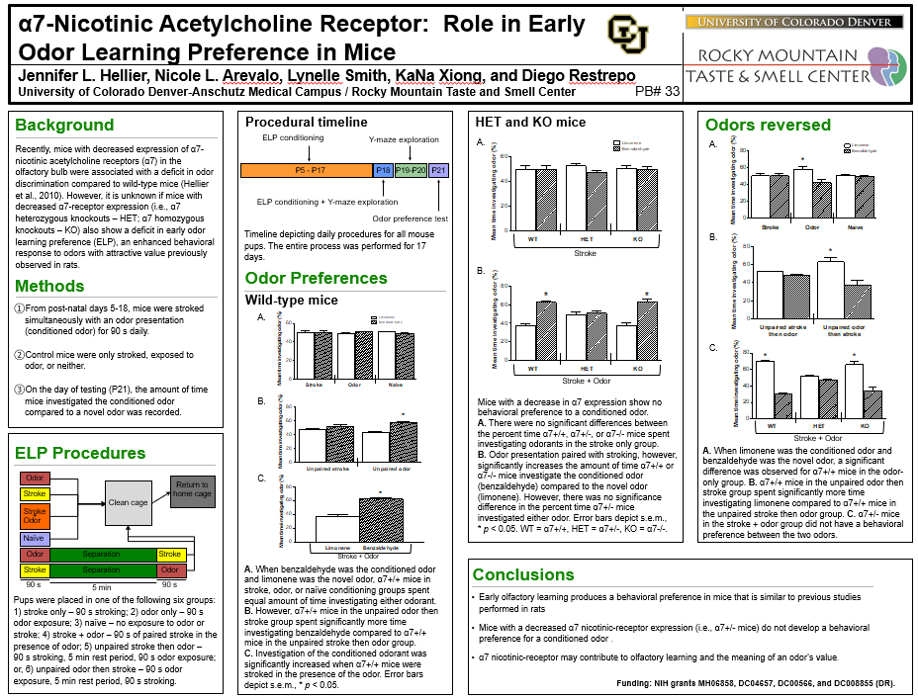
EVALUATE POSTER #2

Slide 21
EVALUATE POSTER #3

Slide 22
REFERENCES & HELPFUL SITES
https://ohiostate.pressbooks.pub/scientificposterguide/chapter/scientific-posters/
https://colinpurrington.com/tips/poster-design/
https://owl.purdue.edu/owl/general_writing/common_writing_assignments/research_posters/research_poster_overview%20.html
https://guides.nyu.edu/posters
https://printcenter.rvu.edu/

Slide 23
Post-survey: Please complete today!
Thank you!

