Slide 1
A 5-year Plan: Trusting the Process
Presented by: Pre-Clinical Career Counseling, Clinical Career Advising, and Clinical Education

Slide 2
Trust the process
RVU has a Residency placement rate of over 99%*
*Classes of 2023 and 2022
Small

Slide 3
Learning Outcomes
Understand broad overview of OMS-I, II, III, IV, Residency
Recognize team members for different parts of your journey
Execute a personal plan—not everyone's medical school journey looks the same
Identify RVU resources
Identify external resources
Q&A
McCoy

Slide 4
Use your team
McCoy

Slide 5
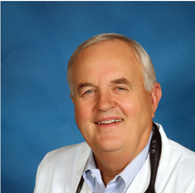
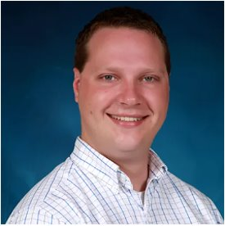
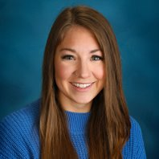
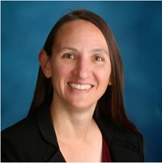
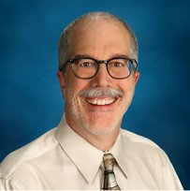
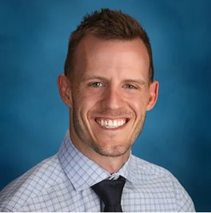
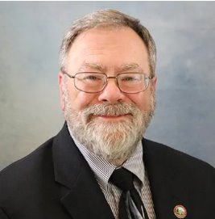
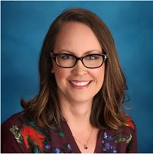
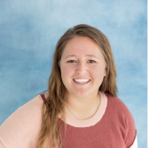
McCoy

Slide 6
OMS-I: Understand Yourself
Explore clubs, organizations, and leadership options
Meet with your career advisor
Complete the CiM Assessments from AAMC
Look for research opportunities and apply for enrichment tracks
Explore volunteer service and community engagement opportunities
Apply for leadership positions
Specialty exploration
Start your CV and keeping track of all activities
Tarleton

Slide 7
OMS-II: Competitive Edge
Career in Medicine assessments and reviews
Height of extracurricular activity: Leadership/Teaching, Volunteering, Research, Professional Development
Meaningful Experiences
Engage with a variety of professional organizations, associations, and academies
Attend conferences, network with physicians
Connect with pre-clinical mentor
Focus on coursework and keep exploring specialties (coursework often determines board success)
Plan and prep for Boards (COMLEX and optional USMLE)
Develop and complete CV in preparation for Clinical Rotation
Attend 3rd year clerkship lottery presentation by Clinical Education for core site selection
Herndon

Slide 8
OMS-III: Specialty Specific Exploration
Explore Specialties through hands-on clinical experiences and online resources
Performance in your clerkships will be communicated to residencies through your MSPE
Meet with your Clinical Career Advisor
Collect Letters of Recommendation
Attend Critical Reflections Course
Schedule Electives and apply for Audition Clerkships
Study and register for Boards (COMLEX Level 2 and possibly USMLE Step 2)
Subject exam performance is a good predictor of future Board performance
Follow residency programs on social media or other avenues to stay up to date on their requirements/timelines
Finch & Leary

Slide 9
OMS-IV: Prepare for Match & Residency
Participate in Audition Clerkships in your preferred (and alternate) specialty choices
Continue collecting Letters of Recommendation, understanding specialty requirements/recommendations
Prepare and submit your ERAS Application (alt. Military, Urology, Ophthalmology, OB-GYN)
Meaningful clubs, organizations, leadership positions, community involvement, academic metrics, research will all be pieces on your application
Residencies are looking for a picture of who you are and whether you "fit" with their program
Research specialties/programs in detail to understand requirements and alignment of your qualifications
Residency interviews and ranking
Match
Graduation
Finch & Small

Slide 10
Residency
Key Factors to ensure a successful Match and Residency transition (“Right fit” vs. “Reach fit”)
Competitiveness
Specialty, Academic Metrics, Board Performance (Level/Step 2 scores), Research/Leadership/Volunteer experiences, Institutional prestige/brand
Residency Match and Program Data
Number of positions offered/specialty and fill rate by applicant type
For U.S. DO Seniors and RVUCOM, the top 5 matched specialties (2023) were: Internal Medicine, Family Medicine, Emergency Medicine, Pediatrics and Psychiatry
-Most competitive specialties
Surgical subspecialties, Dermatology, Otolaryngology, Urology, Ophthalmology
-Competitive specialties
Obstetrics and Gynecology, Anesthesiology, Radiology, Neurology, General surgery
Parallel plan highly encouraged
Haldy

Slide 11
RVU Resources
Writing Center
Mental Health and Wellness Team
WellConnect
Educational Learning Specialists
Library & Library Website
MyVista Career & Professional Development Tab
McCoy

Slide 12
External Resources
AAMC: Careers in Medicine, Residency Explorer, ERAS
AMA: FREIDA
AOA
NRMP Match Data Reports
Main Residency Match timelines
AACOM
ACGME
Professional Specialty Organizations and Associations
Texas Star (student driven information)
Individual program websites
Finch

Slide 13
Questions
McCoy

