Slide 1
RVUCOM Tracks and Electives
Your Road To Personalized Education

Slide 2
Purpose of Tracks and Electives
Support the Mission of RVU by:
Inspiring students to serve with COMPASSION, INTEGRITY, and EXCELLENCE
Help Students to Standout and Personalize Their Education

Slide 3
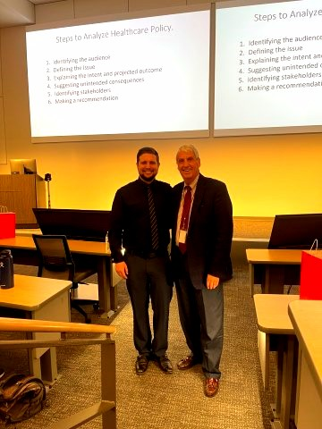
Standing Out / Personalizing Your Education
Clubs, Volunteering, Leadership, Research, Etc.
All Important (and amazing opportunities)
Advantage of Tracks and Electives:
CURRICULAR = Higher Standard, Shows Strong Commitment

Slide 4
TSP Opportunities: TRACKS
Physician Scientist (PST)
Urban Underserved (UUT)
Rural & Wilderness Medicine (RWM)
Global Medicine (GMT)
Digital Health (DHT)
Academic Medicine & Leadership (AML)

Slide 5
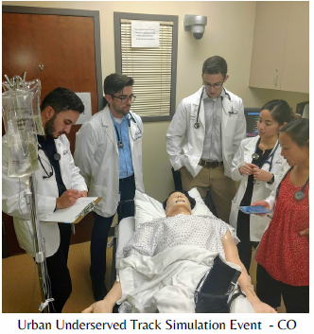
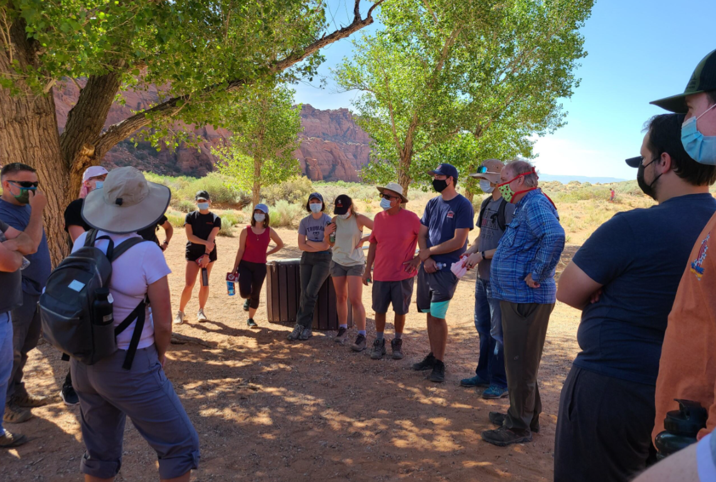
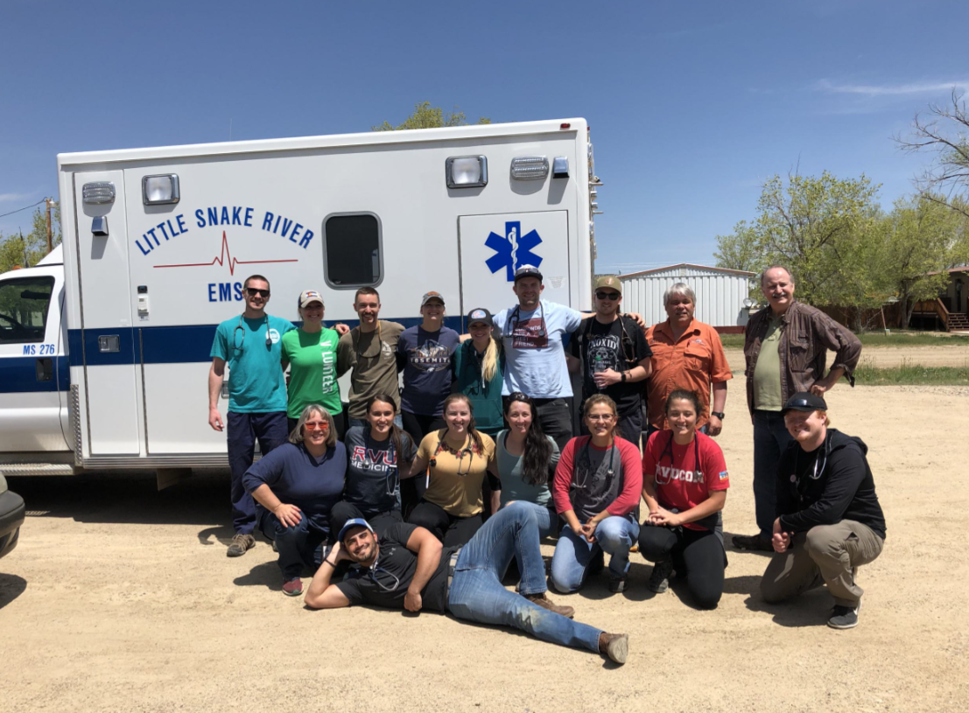
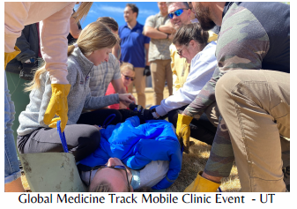
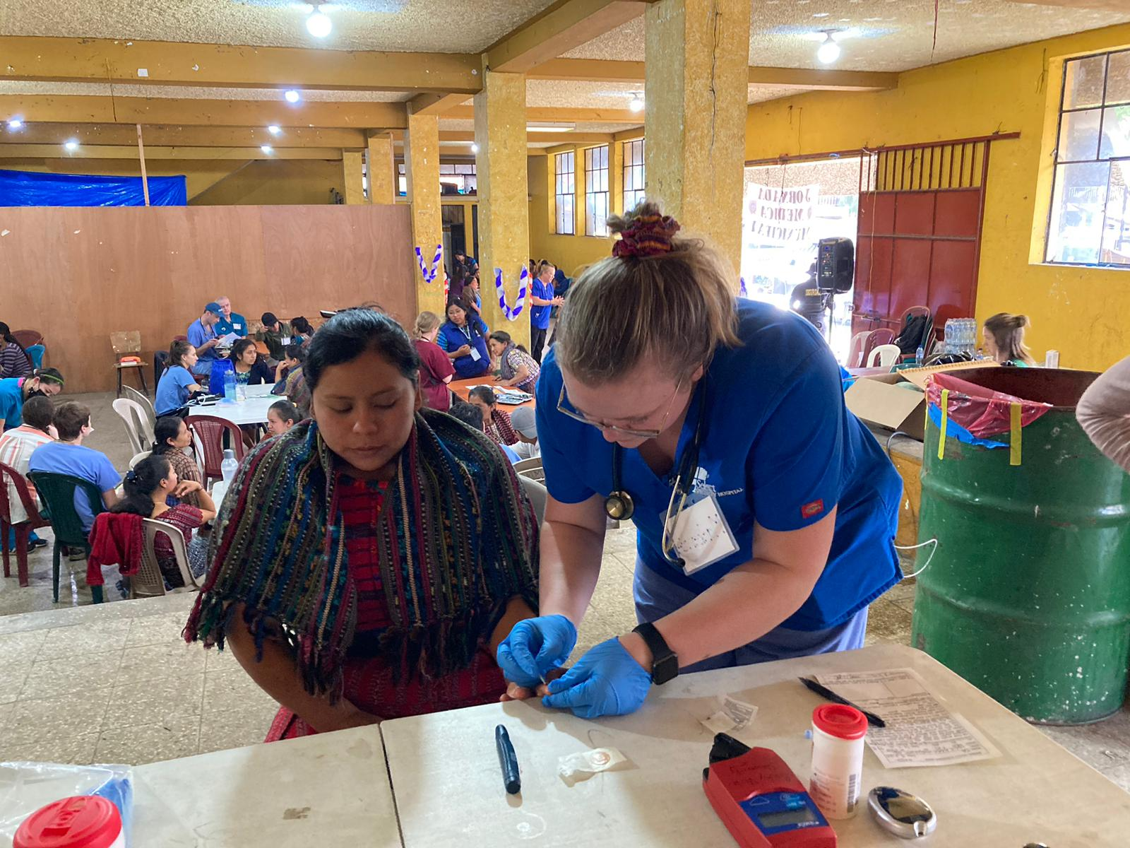
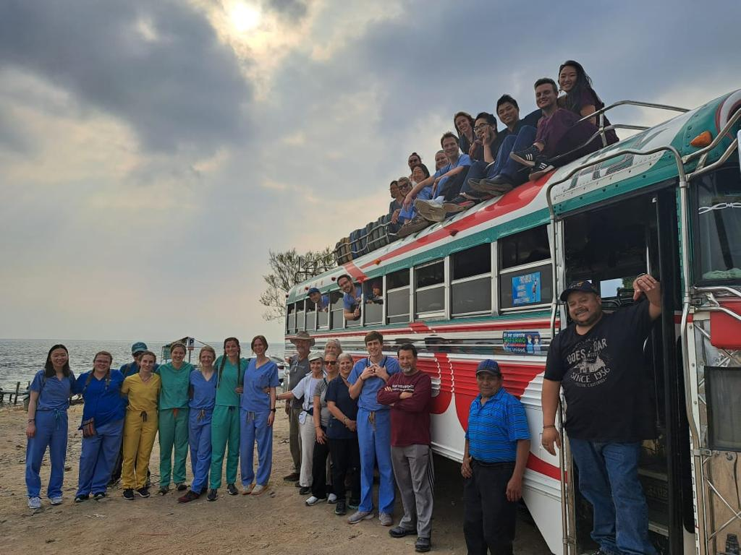

Slide 6
TSP Opportunities: ELECTIVES
Graphic Novels and Medicine
History of Medicine
Integrative Medical Nutrition
Integrative Pain Management
Introduction to Research
Medical Spanish
Medicine in Film
Religion, Health, & Healthcare
Sexual Health
Vaccines
Etc.

Slide 7
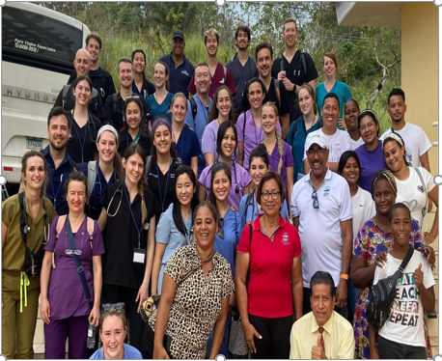
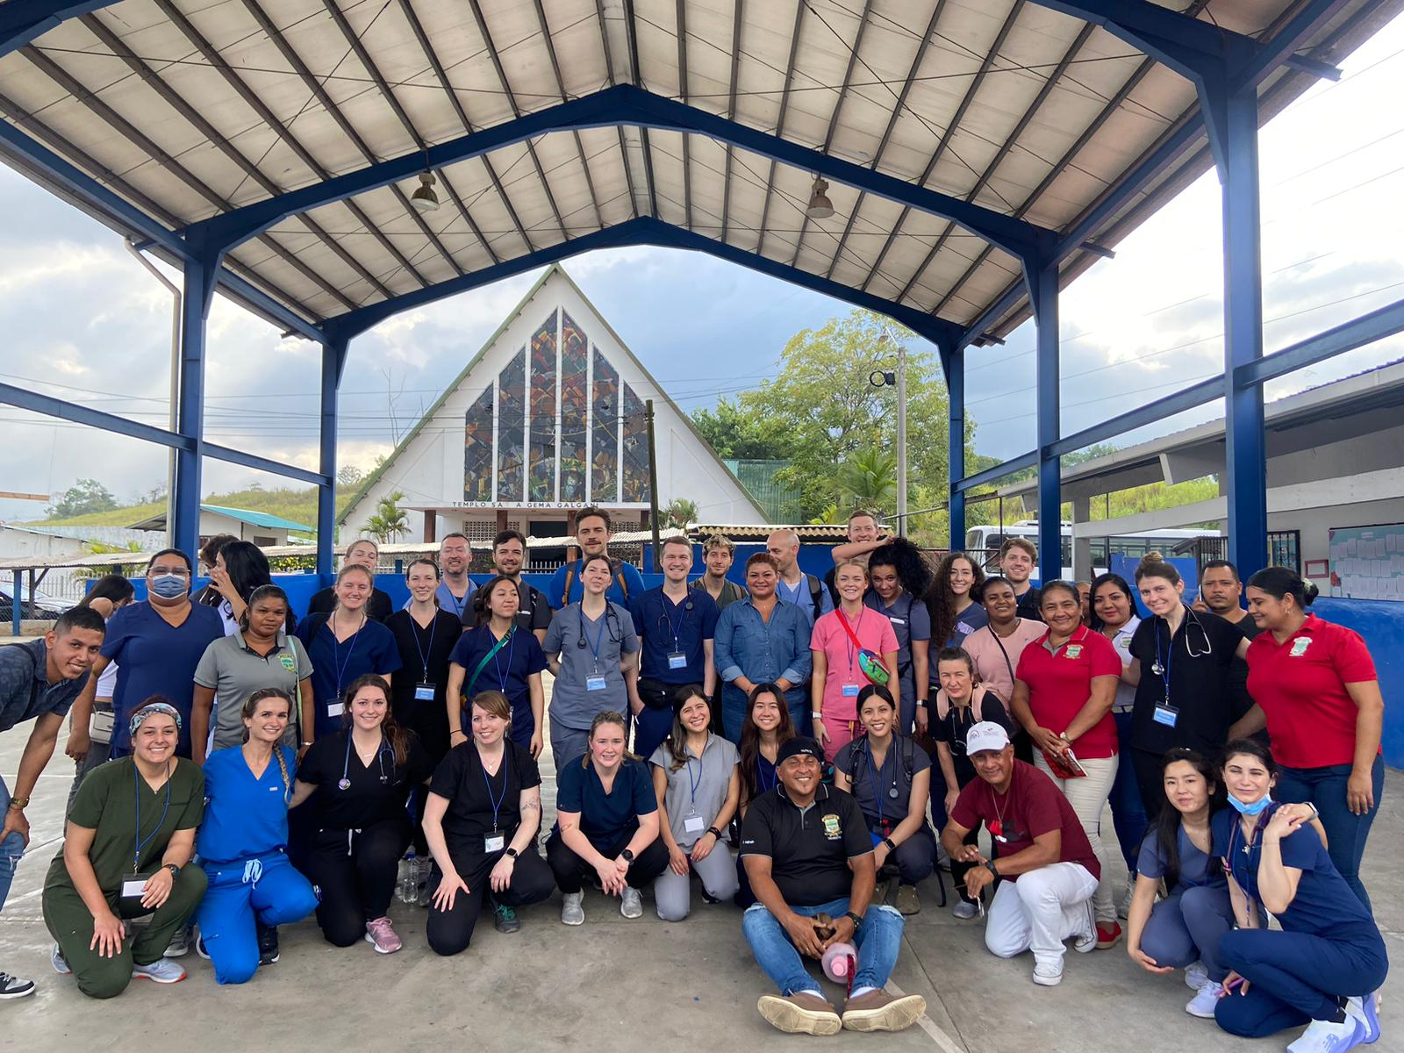
TSP Opportunities: GLOBAL OUTREACH TRIPS
Spring Break Electives as 1st & 2nd year students
Ecuador / Panama / Dominican Republic
3rd & 4th year Elective Rotations
RVU Lead: Kenya / Guatemala
Independent Trips: All over the World!

Slide 8
Stay Tuned…
Spring Break GMO Trips: September for Info / Signup
Tracks: October for Info / Applications
Electives: Early Spring Semester for Info / Signup

